Slide 1
Deep Learning Course
Author: Bo-Syun Cheng
2019/7/23

Slide 2
Outline
Recurrent Neural Network
Sequence to sequence
Autoencoder
Homework
1

Slide 3
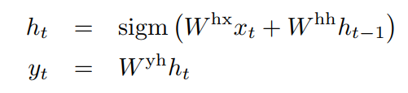
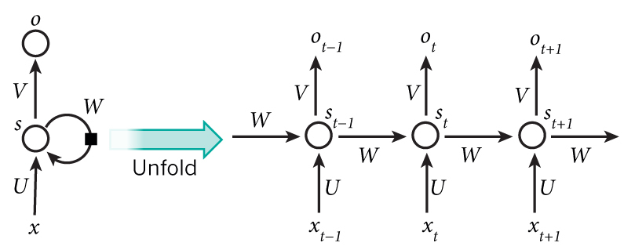
Vanilla RNN Cell
formula :
input
Previous hidden layer output
2

Slide 4
Why RNN?
Memory
Input size and output size are not fixed
3

Slide 5
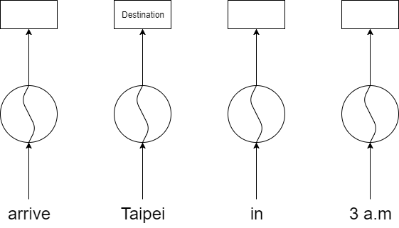

Neural network can’t memorize previous information
4

Slide 6

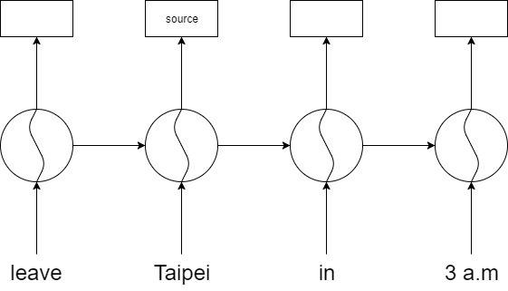
Recurrent Neural Network can memorize previous information
5

Slide 7
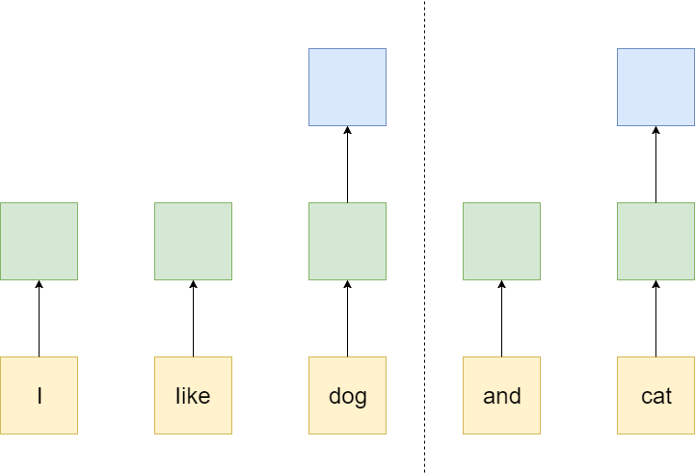
Neural network IO is fixed
6

Slide 8

Recurrent neural network IO isn’t fixed
7

Slide 9
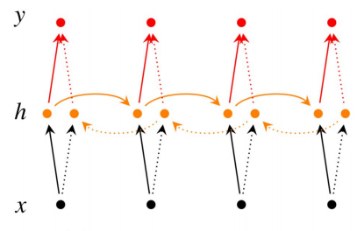
Bidirectional RNNs
8

Slide 10
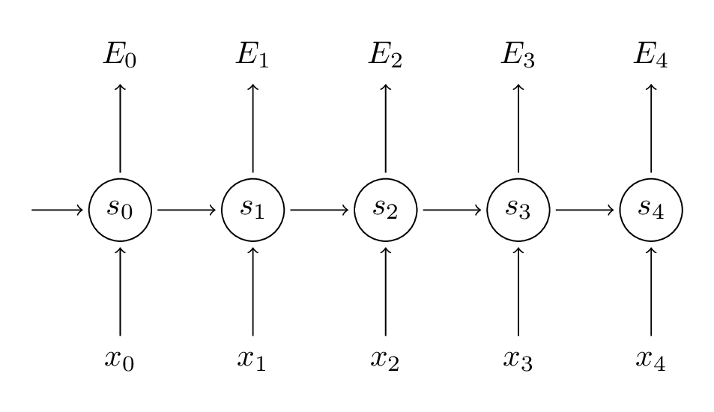

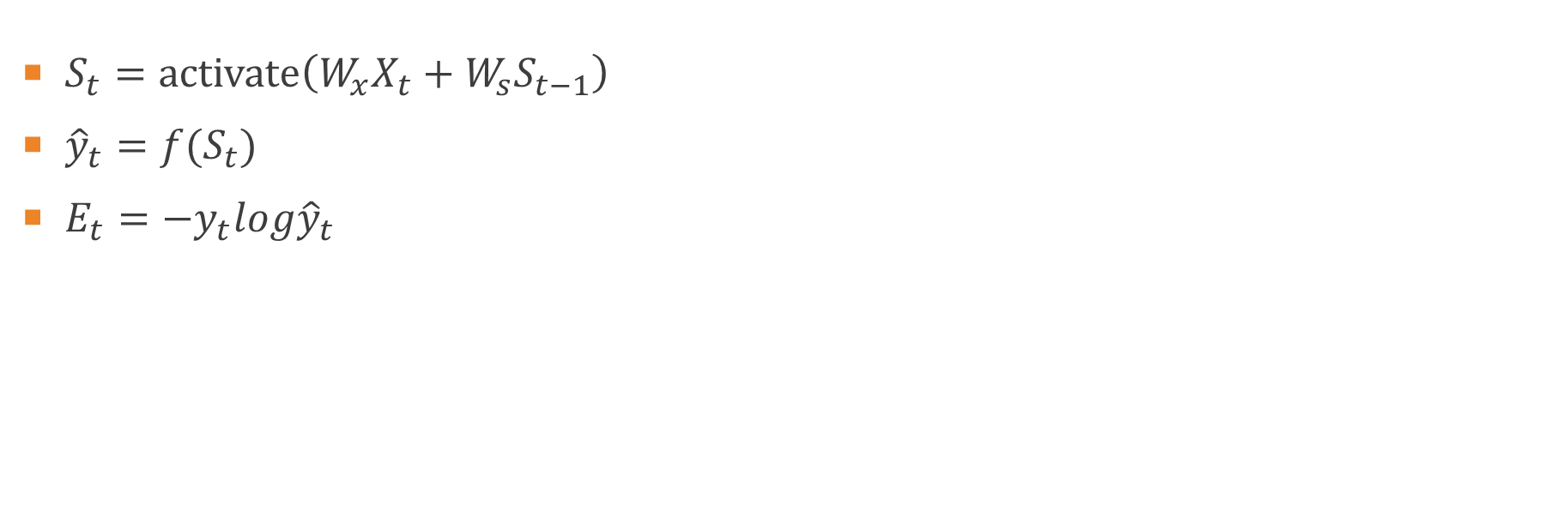
Backpropagation through time
$S_{t}=activate\left(W_{x}X_{t}+W_{s}S_{t−1}\right)$
${\hat{y}}_{t}=f(S_{t})$
$E_{t}=−y_{t}log{\hat{y}}_{t}$
9

Slide 11
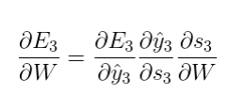
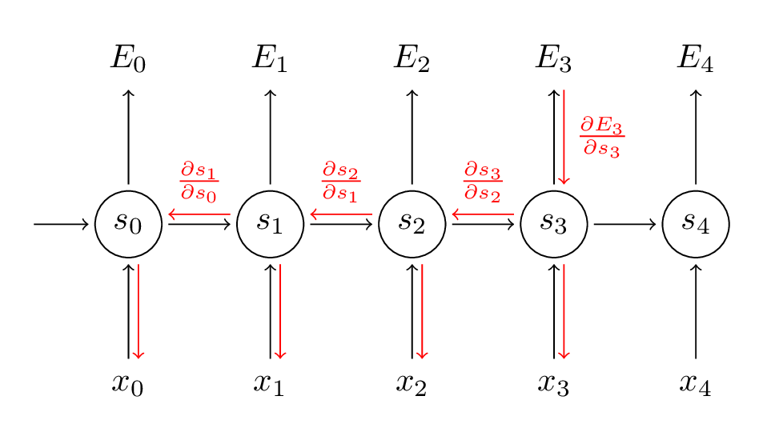
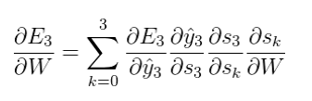
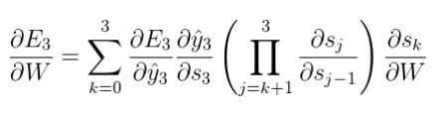
Backpropagation through time
10

Slide 12
Gradient vanishing/exploding
In both forward propagation & backward propagation , weights multiply many times
Gradient > 1 -> Gradient exploding
Gradient < 1 -> Gradient vanishing
This problem appear in any deep learning model , RNN is more obviously
11

Slide 13
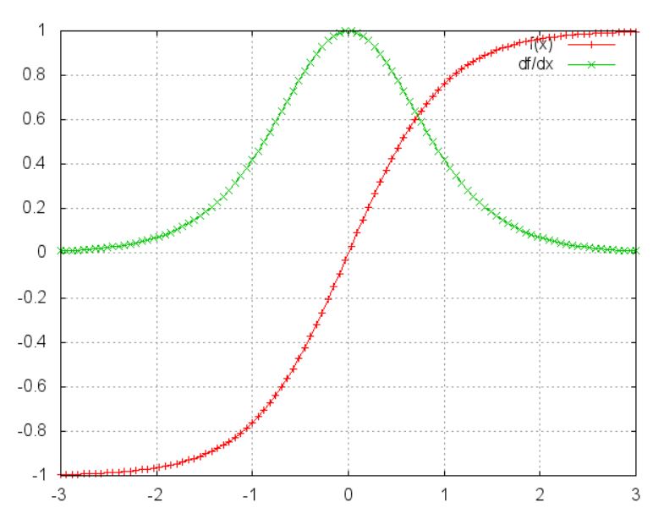
Gradient vanishing
12

Slide 14
How to solve gradient vanishing
Use different activation function , like relu
Long Short-Term Memory networks
etc
13

Slide 15
Long Short-Term Memory networks(LSTM)
https://colah.github.io/posts/2015-08-Understanding-LSTMs/
14

Slide 16
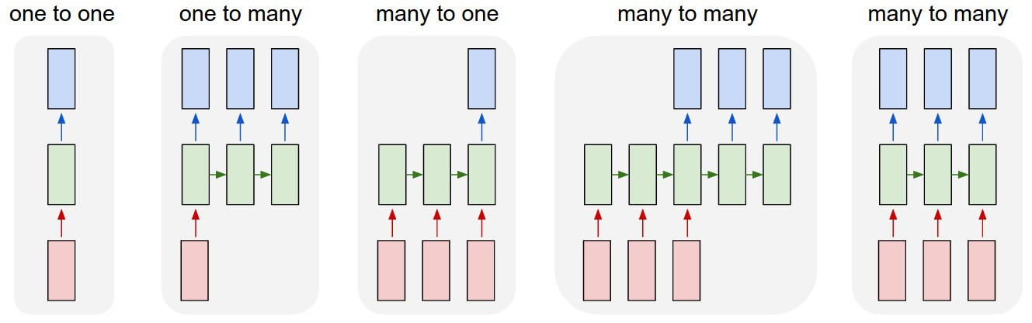
RNN application
image captioning
sentiment analysis
Machine Translation
video classification
16

Slide 17
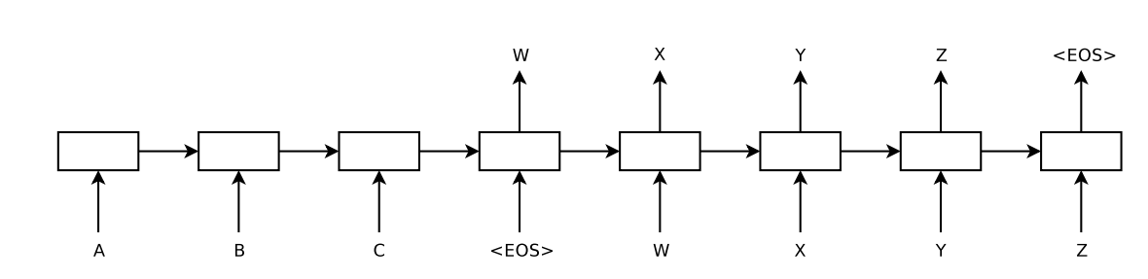
Sequence to sequence
Machine translation
Encoder & decoder
ABC->WXYZ
17

Slide 18
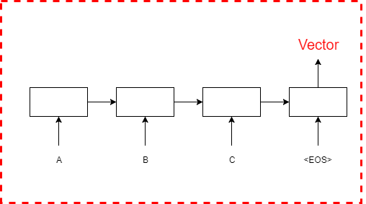
Encoder(Input sequence to vector)
A LSTM model to map variable length sequence to fix-length vectors
18

Slide 19
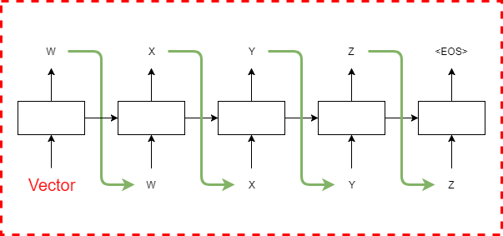
Decoder(Vector to Output sequence)
A LSTM model to map fix-length vectors to variable length sequence
19

Slide 20
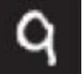
Autoencoder
encoder
784
784
512
512
64
20
decoder

Slide 21
Why Autoencoder?
Dimensionality reduction
Some deep learning model combine autoencoder to do feature extraction
21

Slide 22







Item content
Bag of word
$$X_{2}$$
Joint learning
$$X_{0}$$
$$X_{1}$$
$$X_{3}$$
$$X_{4}$$
$$X_{c}$$
user
item
U
Item
latent
1 | ? | ? | 1 | ?
? | 1 | ? | ? | 1
? | ? | ? | 1 | ?
1 | ? | 1 | ? | ?
? | 1 | ? | ? | 1
User latent
K
V
22
K

Slide 23







Denoising autoencoder
denoising : add noise to input , make the model more robust
Objective function : $\min_{\{w_{l }, b_{l}\}}{{\left\|X_{c}−X_{L}\right\|}_{F}^{2}}$ + $λ \sum_{l}{{\left\|W_{l}\right\|}_{F}^{2}}$
$$X_{2}$$
$$X_{0}$$
$$X_{1}$$
$$X_{3}$$
$$X_{4}$$
$$X_{c}$$
23
Notes:
Add noise to clean input
There are several denoising method – this paper use masking noise 0.3

Slide 24
Reference
RNN : http://www.wildml.com/2015/09/recurrent-neural-networks-tutorial-part-1-introduction-to-rnns/
Seq2seq : https://papers.nips.cc/paper/5346-sequence-to-sequence-learning-with-neural-networks.pdf
24

Slide 25
Homework
實作linear regression : y = ax + b
理解 loss function
實作 gradient decent
不能使用sklearn等套件
25

Slide 26
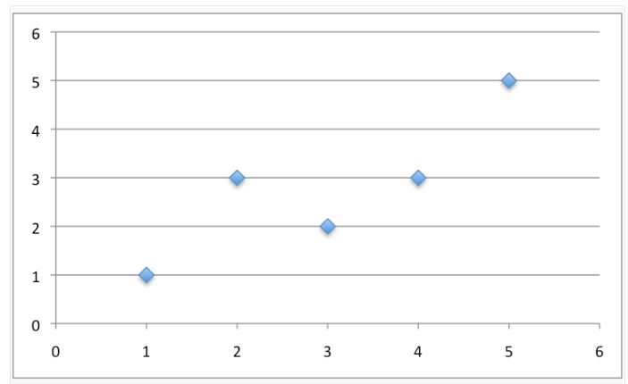
Homework
Step1. 生成資料
自訂a,b
依據a,b生成訓練資料
加入雜訊
26

Slide 27
Homework
Step2. 初始化模型的參數 a,b
Step3. 定義Loss function
Step4. 實作gradient decent
Step5. 觀察參數
27

Slide 28
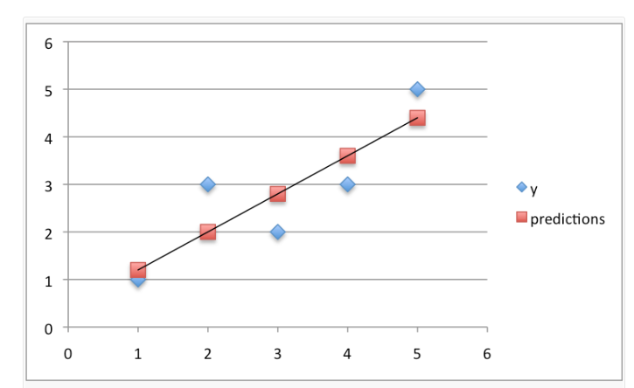
Homework
28

